Slide 1
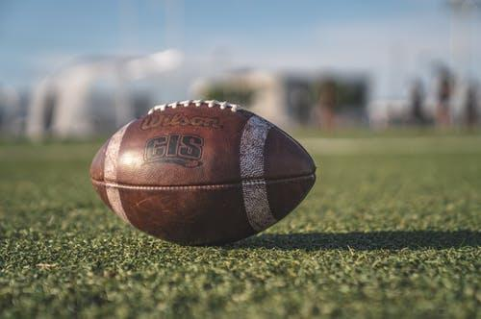
Predicting Wide Receivers Performance in the NFL
A Data Science Capstone Project
Adrien Saremi

Slide 2
Background and Motivations
What is the NFL Draft?
A yearly event, where each team recruits among recent college athletes who declared to play professional.
The General Manager (GM) has a pool of players to choose in order to satisfy the team’s needs.
The Wide Receiver (WR) role is among the most important positions in football and GM’s always allocate resources in recruiting receivers

Slide 3
Background and Motivations
Q: Do performances as a college athlete carry over in the professional league?
Q: Does the NFL combine really have an impact on a WR’s recruitment?
A: It’s not as easy as pie! Many factors come into play: player’s conference of origin, class status upon entry of draft, number of games played at college level...
Recruiters need extensive data in order to recruit WR’s during the NFL draft

Slide 4
Our objective
GM’s are interested in recruits’ performance during first contract (≈ 5 years)
-> Will the player be a success / bust with regards to his receiving yards during the first 5 years?
Our steps:
Capture reliable data
Run statistical tests between features and our target
Build a Machine Learning based model to predict for our target
Test the model against the 2020 draft

Slide 5
Data Wrangling
Use BeautifulSoup to scrape pro-football-reference and sports-reference
Collect the NFL and CFB data for WR’s drafted between 2000 and 2014
Download the combine file from Kaggle and save the data of WR only
Merge the two dataframe
Clean the data.

Slide 6
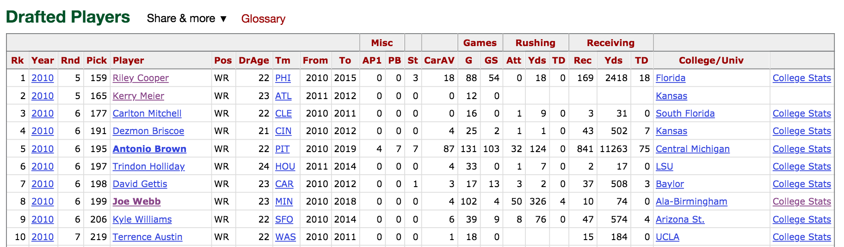
BeautifoulSoup and sports-reference
a) Scrape Table
c) Capture CFB url
b) Capture NFL url
Exceptions: fill in empty entries with np.nan

Slide 7
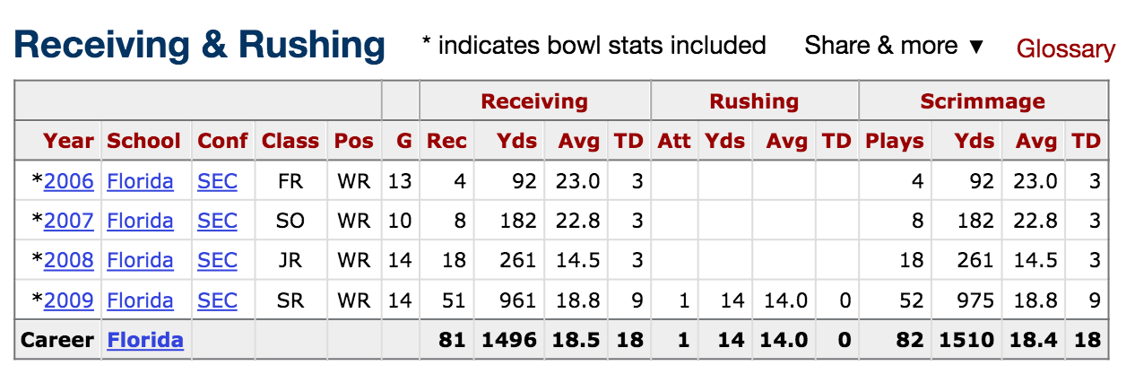
2) CFB page
a) Scrape Table
Issues:
Receiving and Rushing stats are switched
There are multiple schools
b) Capture overall row

Slide 8
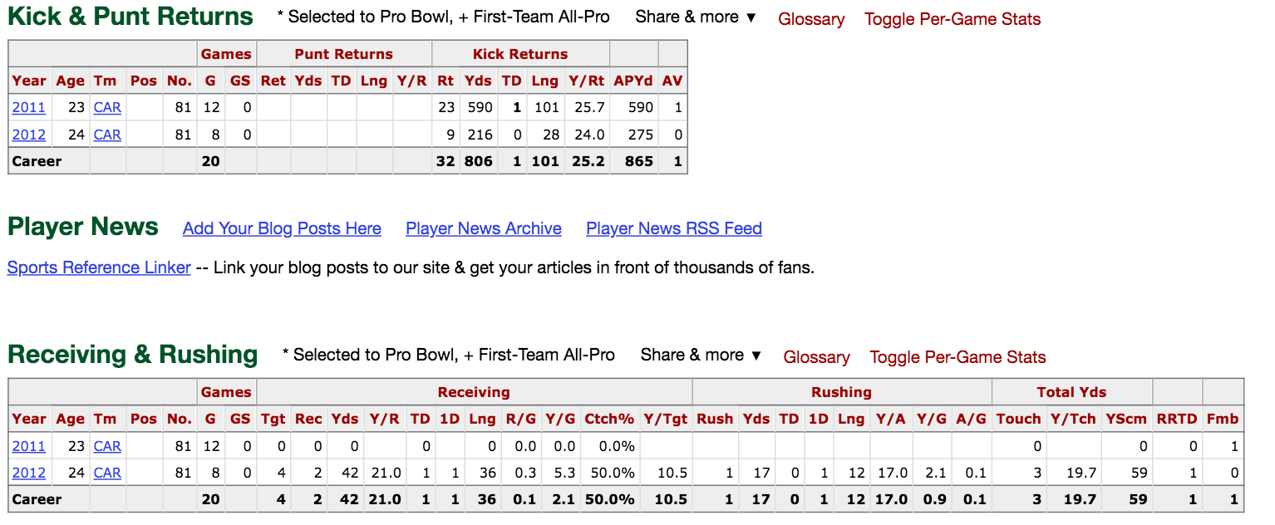
3) Issues: table is hidden in the page
Use the webdriver.Chrome package!

Slide 9
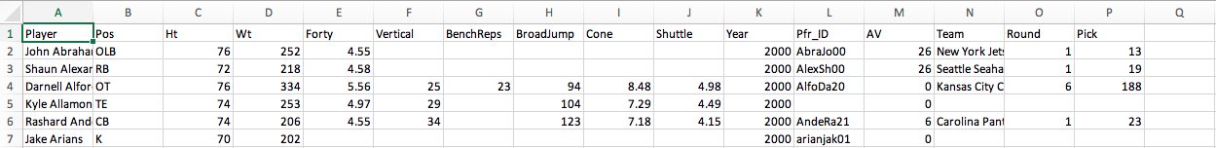
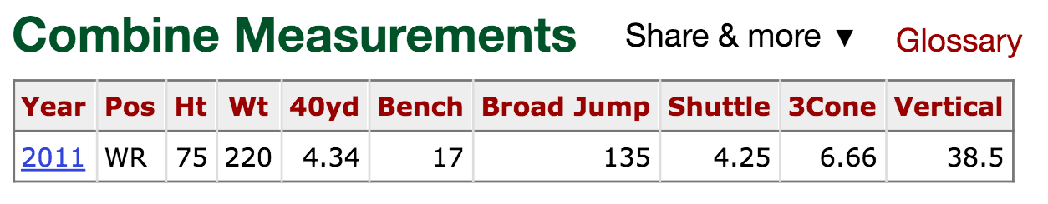
4) The combine table
Download the combine table from the Kaggle website
Search on Pro-football-reference the combine data of each player
Requires:
webdrive.Chrome
data formatting

Slide 10
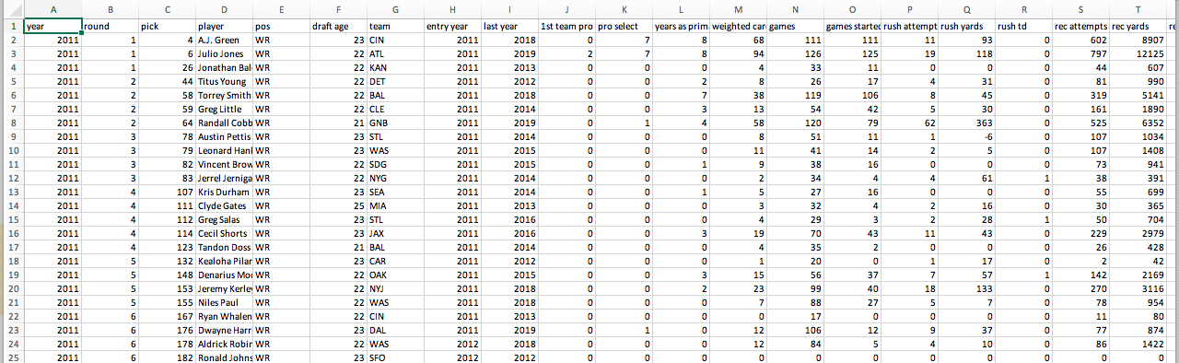
Merging and Cleaning
492 data points
376 with complete CFB, combine data
87 with either cfb or combine data only
25 with both cfb / combine incomplete
26 cfb/combine features

Slide 11
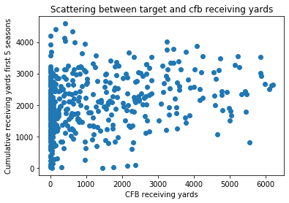
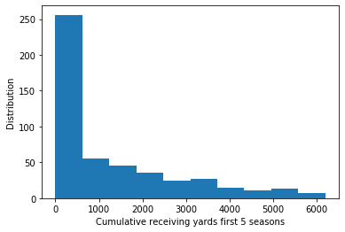
Exploratory phase
Distribution of our target variable. Is there correlation with the cfb data?
A: Let’s start with evident cfb data: receiving yard
Turns out a lot of players are little to not used at all!

Slide 12
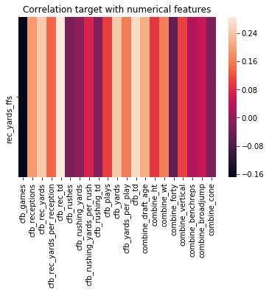
Correlation Matrix
Derive the correlation factor between:
The target: number of rec yards during first 5 seasons and
Numerical features

Slide 13
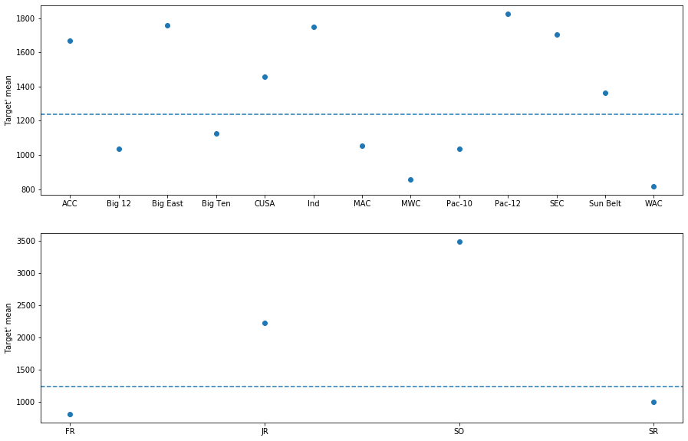
Categorical Data: cfb conference and cfb class

Slide 14
Statistical Analysis
Inferential Tests
Our target: y=’yards first 5 seasons’
For all tests, confidence level: 𝛂 = 95%
SEC vs Big12 - Difference of Means of Two Populations (Bootstrap Inference)
p = 007
Null hypothesis: the sec and big12 samples are from the same distribution with respect to the mean of y
cfb rush attempts - Difference of Means of Two Populations (Scipy t-test)
t = -0.621
p = 0.535
group1, group2: subgroups of players with cfb rush attempts below, above median.
We test for the independence of the two samples with respect to the target y via t-test

Slide 15
Statistical Analysis
Inferential Tests
Our target: y= success vs bust
For all tests, confidence level:
𝛂 = 95%
JR vs SR - Chi Square independence Test (Scipy Stats)
chi = 34.75
p = 3.74 e-9
Null hypothesis: the classes of players and our target are independent distribution

Slide 16
In-Depth Analysis
Target y = yards first 5 seasons
Target: y ≤ 200 ↠ y_{new} = 0 (flop)
y > 200 ↠ y_{new} = 1 (success)
Classification Problem: perform analysis to predict if player is either a flop or a success (binary value based target)
Feature Selections: Pearson correlation, ExtraTreesClassifier
Transformations:
Categorical to numerical (avoid collinearity)
Simple Imputer for missing values (strategy = mean)
Normalize remaining numerical features with MinMaxScaler

Slide 17
Machine Learning Models
LogisticRegression (Scikit-Learn)
KNeighborsClassifier
SVM
Decision Trees
Random Forest
Model:
Selected Model: RandomForest
max_features = 5, number of features to look at each split
n_estimators = 10, number of trees
Min_samples_leaf = 25 minimum number of samples required to be at a leaf node (to avoid overfitting)
Metric: f1-score = 0.70

Slide 18
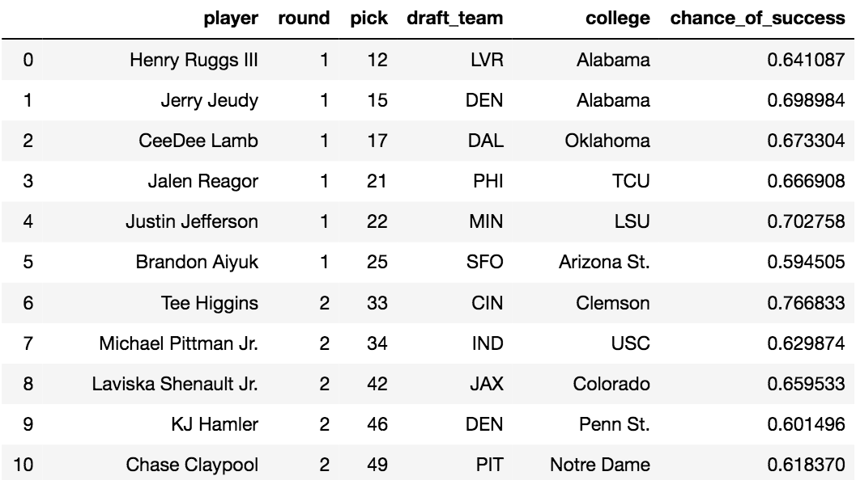
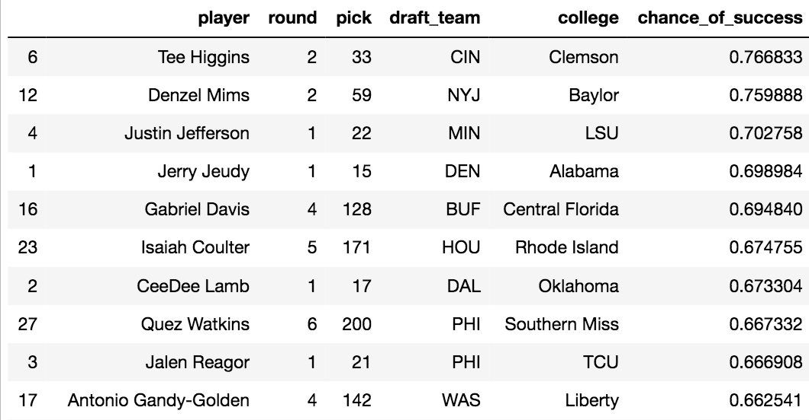
Testing against Class of 2020
P = probability of success
Derive the probability of success of each draftees of 2020
using the predict_proba function of RandomForestClassifier

Slide 19
Conclusion
P = probability of success
Valuable information for a GM when drafting WR’s in the league:
Can help confirm the choice of a draftee.
e.g. 2020 draft: model predicts high values of P for top drafted players
P can be used to establish ranking of players prior to the draft:
Potentially shuffles the order of draftees
Players with little spotlight on and yet high chance of success could be drafted in earlier rounds

Slide 20
Predicting Wide Receivers Performance in the NFL
Thank you!

